Slide 1
University Shared Services Update
Debby zumbach, Associate VP & Director, Business Services and Purchasing

Slide 2
USS Average Total Time for All transactions January – may 2016
10 DAYS

Slide 3
USS Average Total Time for All transactions January – may 2017
5 DAYS

Slide 4
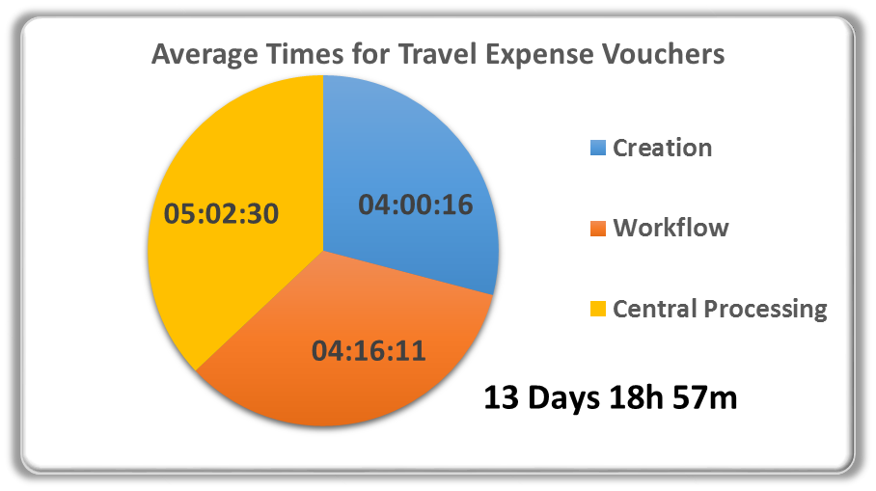
Travel expense vouchers – 6 DAYS IMPROVEMENT
January – May 2016
January – May 2017

Slide 5
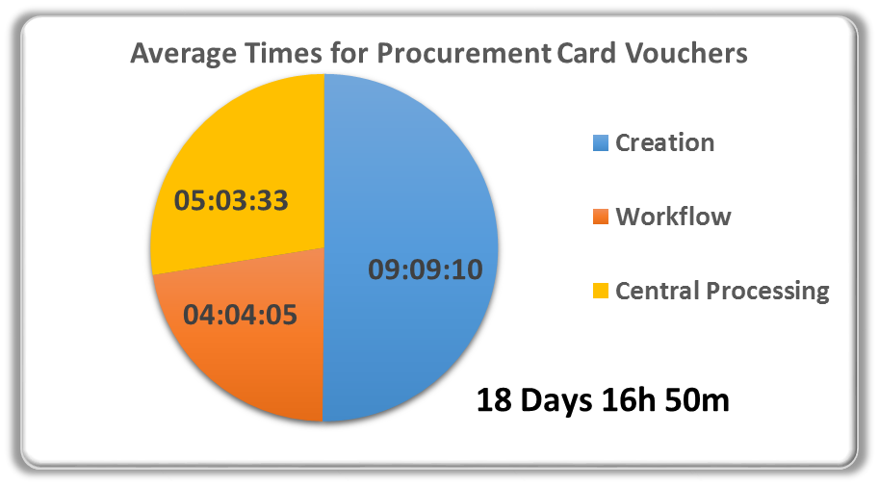
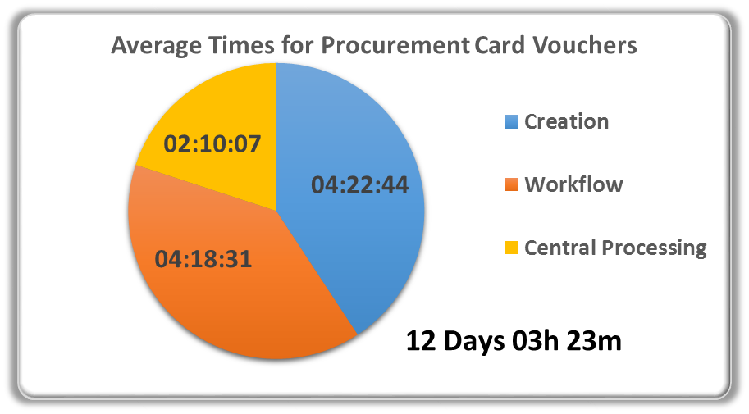
PROCUREMENT CARD vouchers – 6.5 DAYS IMPROVEMENT
January – May 2016
January – May 2017

Slide 6
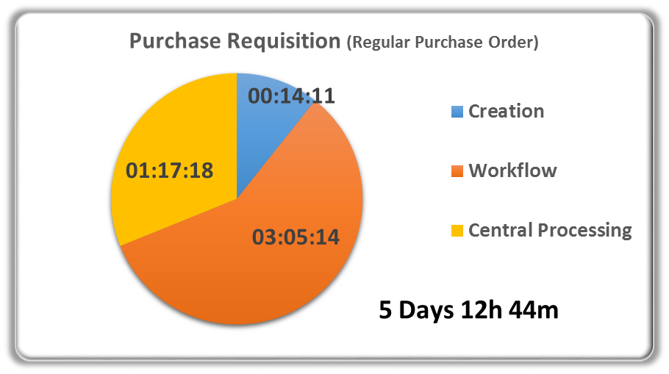
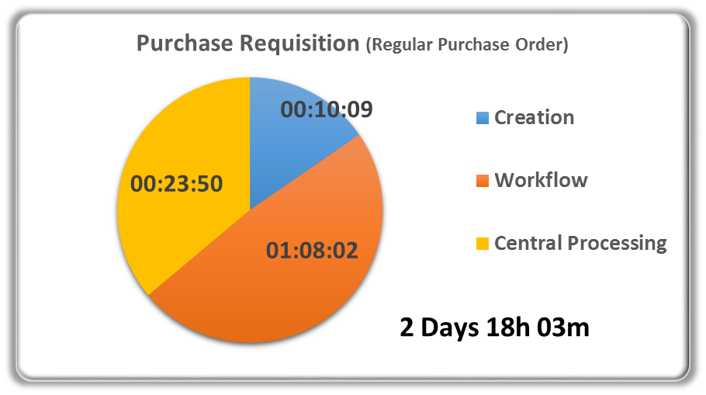
REGULAR PURCHASE REQUISITION – 3 DAYS IMPROVEMENT
January – May 2016
January – May 2017

Slide 7
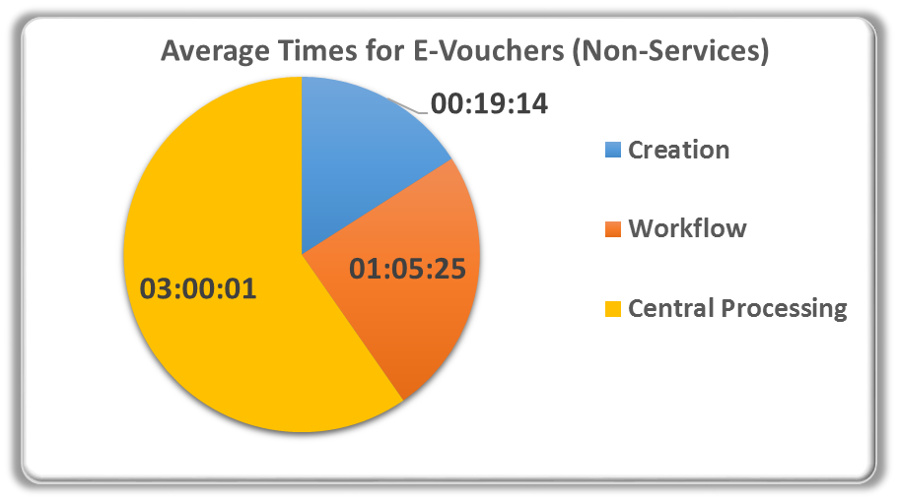
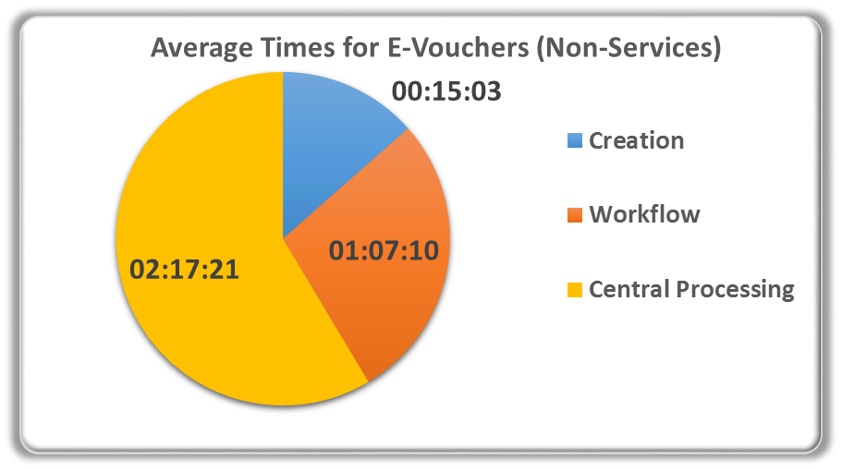
E-VOUCHERS – NON-SERVICES – .5 DAYS IMPROVEMENT
January – May 2016
January – May 2017
4 Days 15h 35m

Slide 8
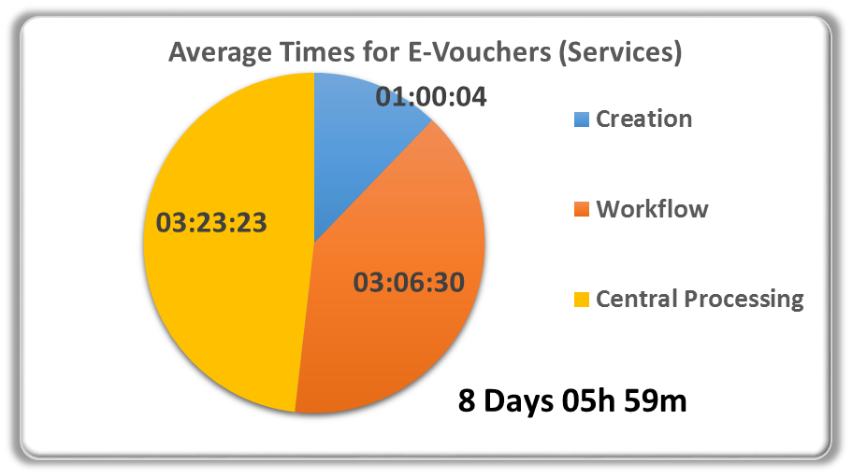
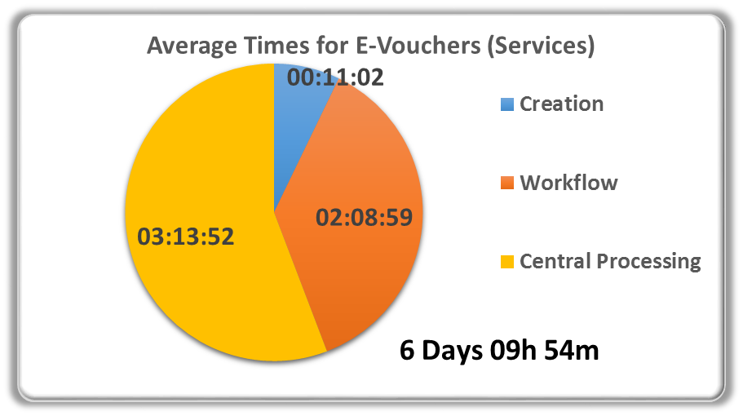
E-VOUCHERS - SERVICES– 2 DAYS IMPROVEMENT
January – May 2016
January – May 2017

Slide 9
AUDIT ERRORS
January – May 2016
January – May 2017

Slide 10
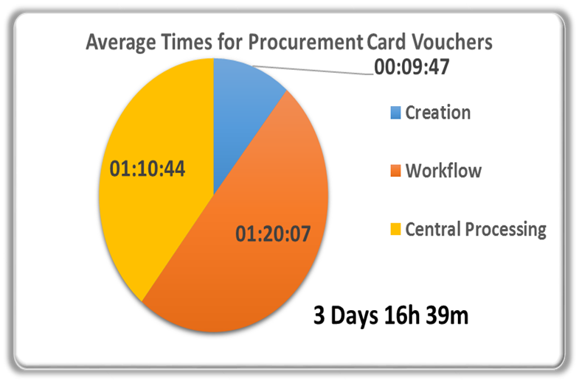
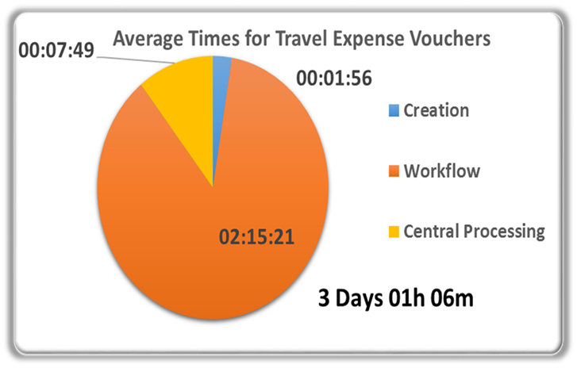
ORG UNIT BEST IN CLASS
PROCUREMENT CARD VOUCHERS
TRAVEL EXPENSE VOUCHERS
Notes:
PCARD COLLEGE OF NURSING TEV OVPRED

Slide 11
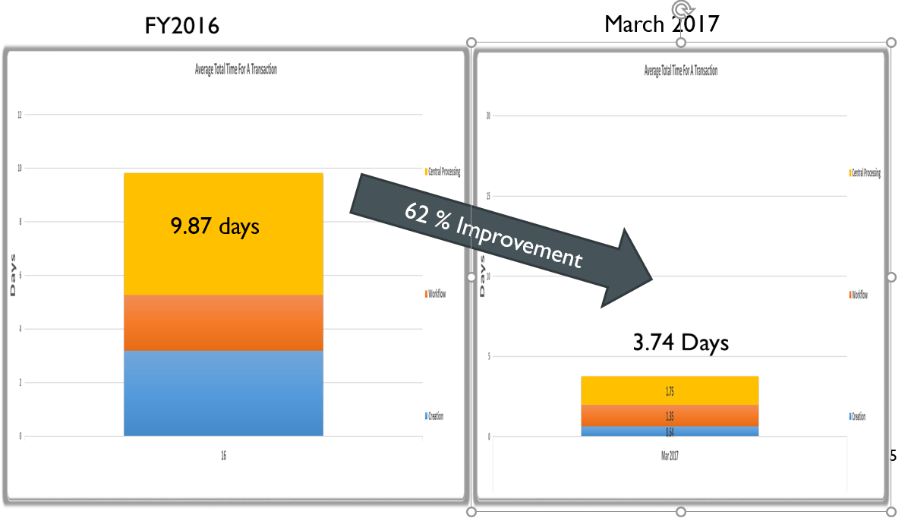
ORG UNIT BEST IN CLASS - OVERALL
Notes:
COLLEGE OF LAW

Slide 12
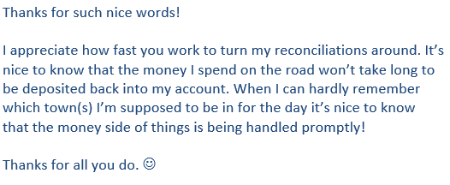
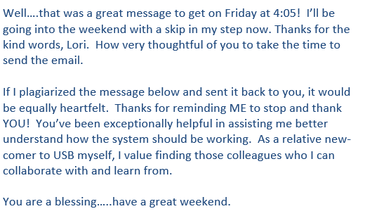
CUSTOMER APPRECIATION DAY – JUNE 9TH

Slide 13
NEXT STEPS
SURVEY CUSTOMERS FOR FEEDBACK
REVIEW PROCESSES TO OPTIMIZE
SHARE RESULTS AND BEST PRACTICES
CHERYL NIEMEYER WILL BE LEADING THIS EFFORT

